Slide 1

Research Review 2025
Comparative Approaches to Automating
Bloom's Taxonomy
Classification
Large Language Models (LLMs) vs. Traditional Machine Learning
in Educational Assessment
Literature Review Analysis
Academic Research
Six Key Studies • 2025
Comparative Methodology

Slide 2
Presentation Overview
Research Overview
01
Introduction & Research Context
02
Comparative Methodologies
Understanding the landscape of automated Bloom's Taxonomy classification, the cognitive framework, and the six key studies forming this review's foundation.
Analyzing the critical trade-offs between prompt engineering vs. fine-tuning approaches and LLMs vs. traditional machine learning methods.
03
Practical Applications & Tools
Synthesis & Future Directions
04
Examining real-world implementations including Bloomify chatbot and Socratic dialogue systems, plus critical analysis of current LLM benchmarks.
Synthesizing comparative methodologies and identifying future research directions for higher-order cognitive skill assessment.
Key Focus: Performance Trade-offs • Cost Efficiency • Educational Impact
6 Research Papers
Comprehensive Analysis

Slide 3

01
Introduction &
Research Context
Understanding the landscape of automated Bloom's Taxonomy classification in educational assessment
Theoretical Framework
Research Landscape

Slide 4
Cognitive Framework
Bloom's Taxonomy: The Cognitive Framework
The Revised Taxonomy (2001)
Six Cognitive Levels Hierarchy
Bloom's Taxonomy provides a hierarchical model classifying educational learning objectives into six cognitive levels , progressing from lower-order to higher-order thinking skills. The 2001 revision by Anderson & Krathwohl restructured the original 1956 framework, emphasizing active verbs and recognizing creativity as the highest cognitive process.
6
Create
Highest
Generate, plan, construct, design
5
Evaluate
Judge, critique, test, monitor
This framework serves as the foundation for educational assessment , enabling educators to classify learning outcomes, design appropriate assessments, and ensure curriculum alignment across cognitive complexity levels.
Analyze
4
Compare, attribute, organize, deconstruct
3
Apply
Execute, implement, use, demonstrate
Why Automate Classification?
2
Understand
Scalability: Manual classification of thousands of learning outcomes is time-intensive
Interpret, exemplify, classify, summarize
Consistency: Human annotators show inter-rater variability (60-80% agreement)
Remember
1
Lowest
Recognize, recall, retrieve
Real-time Analysis: Dynamic assessment requires instant cognitive level identification
Source: Anderson & Krathwohl (2001) — A Taxonomy for Learning, Teaching, and Assessing

Slide 5
Literature Review
Research Landscape: Six Key Studies
ID | Study Focus | Methodology | Key Finding
1 | Course Learning Outcomes (CLOs) Almatrafi & Johri (2025) | LLMs: GPT-4 (Zero-shot, Few-shot, CoT, Rhetorical Situation) ML: Fine-tuned BERT | Rhetorical Situation prompts achieved highest performance; fine-tuned BERT showed superior overall performance
2 | Exam Questions & Learning Outcomes Kumar, Gulwani & Singh (2025) Dataset: 600 sentences | ML: SVM, NB, Logistic Regression, LSTM DL: BERT, RoBERTa LLMs: GPT-4o-mini, Gemini, Llama 3.1, Claude 3.5 | SVM with data augmentation: 94% accuracy; BERT/RoBERTa suffered from overfitting; Gemini & GPT-4o-mini: 72-73% accuracy
3 | Learning Objectives (LOs) from Course Descriptions Kolagar, Zalkow & Zarcone (2025) Dataset: 35 LOs | LLM: GPT-4 (MCS, PWC, BWS, BCA, RCA) Non-LLM: Regex, Fuzzy Matching, SpaCy, Semantic Similarity | LLM-based methods (Best-Worst Scaling) consistently outperformed non-LLM methods; GPT-4 shows minimal prompt-induced bias
4 | LLM Benchmarks Analysis Huber & Niklaus (2025) 43 benchmark tasks | Annotation: Human + LLM (GPT-4, Claude 3, Llama 3) + RoBERTa | Current benchmarks overrepresent lower-order thinking (Understand, Apply, Analyze); lack coverage of Evaluate, Create, Metacognitive levels
5 | Engineering Question Papers (SPPU) Atre et al. (2025) Bloomify Chatbot | LLM: Mistral 7B fine-tuned with QLoRA | Mean Opinion Scores: 8-9.5 for classification, suggestion, generation; automated Bloom's Score calculation
6 | Socratic Student-Chatbot Dialogues Lee, Ang & Lai (2025) Statistics course | ML: SentenceTransformer + Logistic Regression, SVM, XGBoost, MLP LLM: Fine-tuned GPT-4o-mini | Fine-tuned GPT-4o-mini: micro-F1 0.814; Linear SVM: macro-F1 0.630 — superior for rare higher-order labels
LLM-Based
Traditional ML
Hybrid
All studies published in 2025

Slide 6

02
Comparative
Methodologies
Analyzing the trade-offs between different automation approaches in educational assessment
Performance Analysis
Cost Efficiency

Slide 7
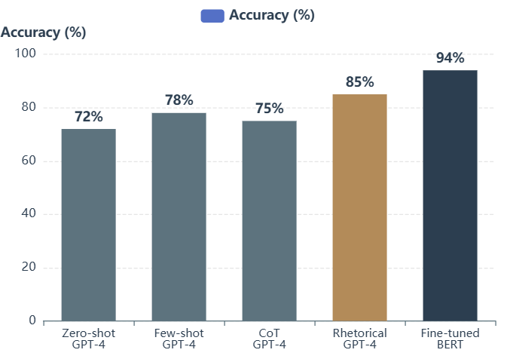
Methodological Trade-off
The Prompt Engineering vs. Fine-Tuning Trade-off
Key Finding: Fine-Tuned BERT Superior
Performance Comparison
Almatrafi & Johri (2025) found that fine-tuned BERT achieved near-perfect agreement with expert annotators , significantly outperforming all prompt-based GPT-4 methods for Course Learning Outcomes classification.
Rhetorical Situation Prompts: Among prompting strategies, those incorporating audience and contextual information achieved the highest performance, demonstrating the importance of domain-specific framing.
Chain-of-Thought Paradox: Despite offering transparency and explainability , CoT prompting did not improve classification accuracy and led the model to "over-analyze" inputs, introducing unnecessary complexity.
Prompt Engineering Strategies Tested
Zero-shot: Direct classification without examples
Few-shot: Includes example classifications
Chain-of-Thought: Step-by-step reasoning
Rhetorical Situation: Context-aware prompts
Cost Analysis
Time to Deploy
Prompt Engineering: $0-500/month
Prompt Engineering: Hours to days
Multiple Binary Questions: Sequential decision tree
Fine-Tuning: $5K-50K upfront
Fine-Tuning: Weeks to months
PE for prototyping; FT for scale
PE offers rapid iteration

Slide 8
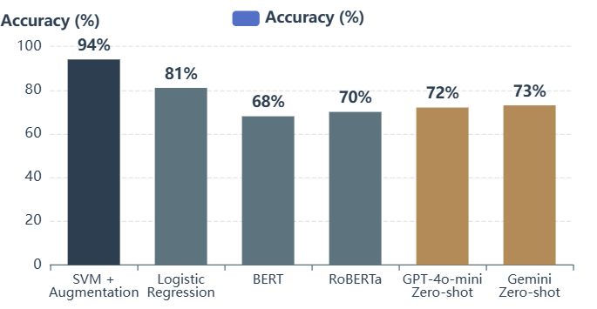
Model Performance Comparison
LLMs vs. Traditional & Non-LLM Methods
Accuracy Comparison: Small Dataset (600 sentences)
LLM Superiority: Consistent Outperformance
Kolagar et al. (2025) demonstrated that LLM-based methods (specifically GPT-4) consistently outperformed non-LLM approaches including Regex, fuzzy matching, SpaCy, and semantic similarity methods.
Resilience Against Bias: GPT-4 showed minimal evidence of prompt-induced bias (positional or verbosity), addressing a common concern in LLM deployments.
Best-Worst Scaling (BWS): Among LLM-based methods, BWS annotation technique delivered the most reliable classifications, leveraging comparative judgment rather than absolute ratings.
Traditional Model Resilience: SVM Success
The Nuanced Reality: Micro vs. Macro F1
Kumar et al. (2025) revealed a surprising result: on small datasets (600 sentences), traditional Support Vector Machine (SVM) with synonym augmentation achieved 94% accuracy , outperforming both BERT and zero-shot LLMs.
Lee et al. (2025) revealed critical metric-dependent performance differences in Socratic dialogue classification:
BERT Overfitting: Deep learning models (BERT, RoBERTa, LSTM) suffered from severe overfitting on the small dataset, highlighting the data efficiency advantage of traditional ML.
Micro-F1 (Overall Performance): Fine-tuned GPT-4o-mini achieved 0.814, best weighted performance
LLM Zero-Shot Limitations: GPT-4o-mini and Gemini achieved only 72-73% accuracy in zero-shot settings, demonstrating the challenge of generalization without task-specific adaptation.
Macro-F1 (Balanced Performance): Calibrated Linear SVM achieved 0.630, superior for preserving rare higher-order labels
Key Insight: Traditional ML excels at detecting rare, higher-order thinking skills (Evaluate, Create) that are critical for educational assessment but underrepresented in training data.

Slide 9
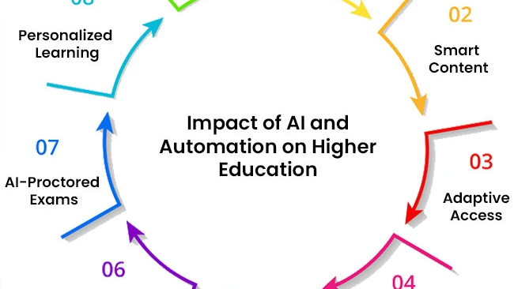
03
Practical
Applications & Tools
From static classification to dynamic educational systems
AI Chatbots
Socratic Dialogue

Slide 10
Applied Systems
Real-World Implementations: Bloomify & Socratic Dialogue
Bloomify Chatbot
Socratic Dialogue Analysis
Atre et al. (2025)
Lee, Ang & Lai (2025)
Bloomify represents a production-ready implementation of automated Bloom's Taxonomy classification, deployed as an interactive chatbot for engineering question papers at SPPU (Savitribai Phule Pune University).
Dynamic Classification: Moving beyond static text analysis, this study applied Bloom's Taxonomy to real-time student-chatbot interactions in a Statistics course, tagging conversational turns during Socratic dialogue.
Technical Architecture
Research Context
Base Model: Mistral 7B (open-source LLM)
Domain: Statistics education
Fine-Tuning: QLoRA (Quantized Low-Rank Adapters)
Methodology: Socratic questioning via AI chatbot
Advantage: Memory-efficient adaptation without full model retraining
Gold Labeling: 3 students (8.8% of cohort) manually annotated
Scale: Model-based labeling for remaining dialogues
Performance Metrics
8-9.5
3
Auto
Methodological Approaches
Mean Opinion Score
Core Functions
BS Calculation
Traditional ML: SentenceTransformer + Logistic Regression, SVM, XGBoost, MLP
LLM: Fine-tuned GPT-4o-mini
Bloomify's Three Core Capabilities
Evolution: Static → Dynamic
1
Classification: Automatically categorizes exam questions into Bloom's levels
Static Analysis: Classifying learning outcomes, exam questions
Interactive Systems: Real-time chatbot classification (Bloomify)
2
Suggestion: Recommends cognitive level adjustments for better alignment
Dynamic Dialogue: Socratic conversation tagging (Lee et al.)
3
Generation: Creates new questions at specified cognitive levels
Future Direction: Integration of RAG and Stable Diffusion for diagram generation

Slide 11
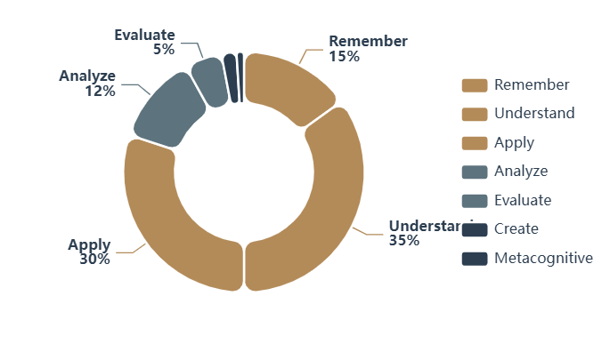
Critical Analysis
Critique of Current LLM Benchmarks
The Benchmark Gap
Benchmark Task Distribution Across Bloom's Levels
Huber & Niklaus (2025) conducted a critical analysis of popular LLM benchmarks (MMLU, AGIEval, BIG-Bench Hard) and discovered a systematic bias toward lower-order thinking skills .
Key Finding: Current benchmarks heavily overrepresent Remember, Understand, and Apply levels while lacking sufficient coverage of Evaluate, Create, and Metacognitive levels.
Implication: Our evaluation metrics may not accurately reflect LLMs' true capabilities for complex cognitive tasks, creating a disconnect between benchmark performance and educational needs.
Methodology: Multi-Source Annotation
The study mapped 43 benchmark tasks to Bloom's Taxonomy using three annotation approaches:
Lower-Order Overrepresentation
Higher-Order Underrepresentation
Remember: ~15%
Analyze: ~12%
1
Human Annotation: Expert educators classified tasks
Understand: ~35%
Evaluate: ~5%
2
LLM Annotation: GPT-4, Claude 3, Llama 3 classifications
Apply: ~30%
Create: ~2%
Total: ~80%
Metacognitive: ~1%
3
RoBERTa: Fine-tuned model for automated classification
Total: ~20%

Slide 12
Research Synthesis
Synthesis & Future Directions
Priority Research Directions
Core Synthesis
The field must synthesize comparative methodologies to determine when resource-heavy LLMs are appropriate versus efficient traditional models , particularly for identifying higher-order cognitive skills which remain challenging for current automated systems.
1
Enhanced Benchmarks
Develop evaluation frameworks with balanced coverage of all cognitive levels, especially Evaluate and Create
Key Insight: No single approach dominates. The optimal method depends on dataset size, performance metrics (micro vs. macro F1), cost constraints, and the specific cognitive levels being targeted.
2
Hybrid Architectures
Combine LLM capabilities with traditional ML efficiency, leveraging strengths of each approach
3
Multilingual Expansion
Critical Research Gaps
Extend automated classification to German, Spanish, Chinese, and other major educational languages
Higher-Order Skills: Evaluate and Create levels remain underrepresented in both benchmarks and automated classification systems
4
Technical Content Handling
Small Data Efficiency: Traditional ML (SVM) outperforms deep learning on limited datasets, yet this advantage is underexplored
Address mathematical notation, code syntax, and diagram interpretation in classification pipelines
Multilingual Support: Current research focuses predominantly on English; expansion to other languages is critical
Technical Content: Mathematical formulae and coding questions pose unique challenges for classification systems
The future lies not in choosing between LLMs and traditional ML, but in intelligently orchestrating both to achieve educational assessment at scale.

